Slide 1
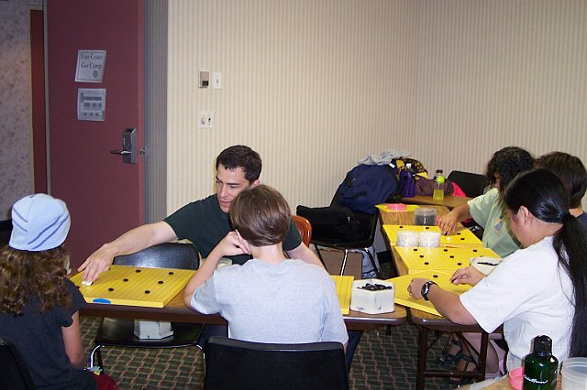
Michael Redmond, 9-dan, plays against the beginner class

Slide 2
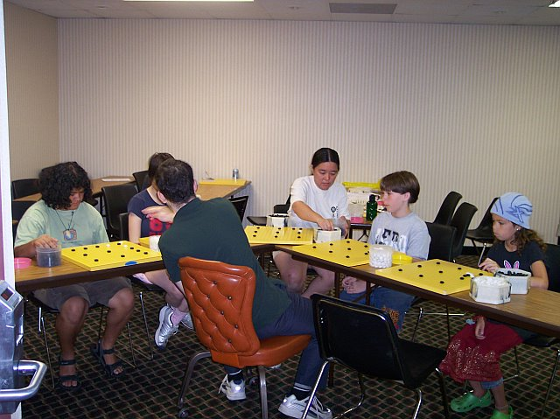
Michael Redmond, 9-dan, plays against the beginner class

Slide 3
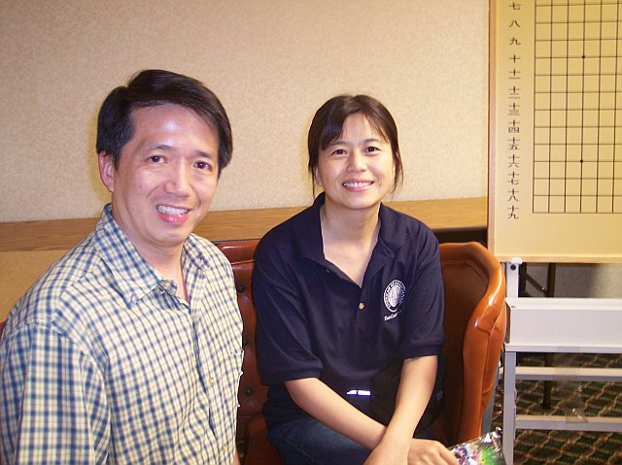
Days Inn owner, and go player, Steven Wu, saved the day by offering his hotel when the original camp site was flooded. Xian Xian Niu, 3-dan, (Michael Redmond's wife) also taught at the camp.

Slide 4
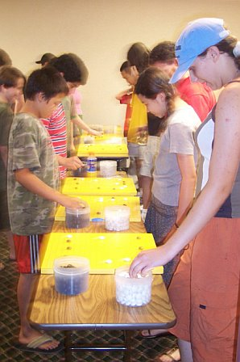
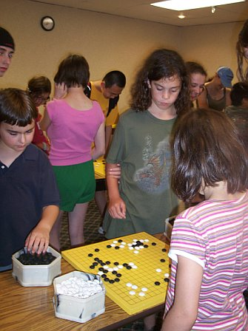
Campers played various forms of go - team go, speed go, human go...

Slide 5
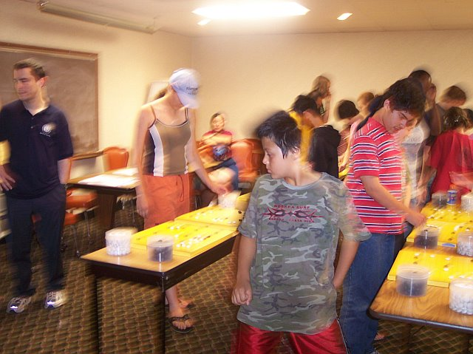
Speed Go

Slide 6
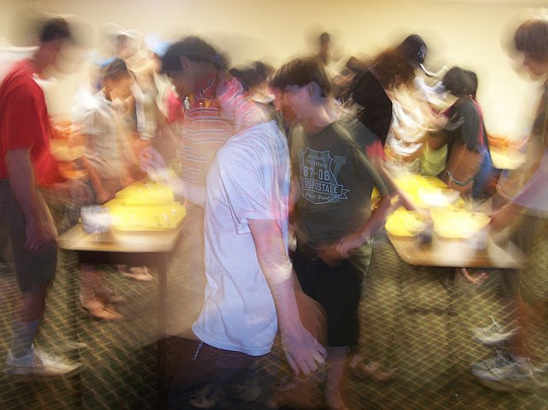

Slide 7
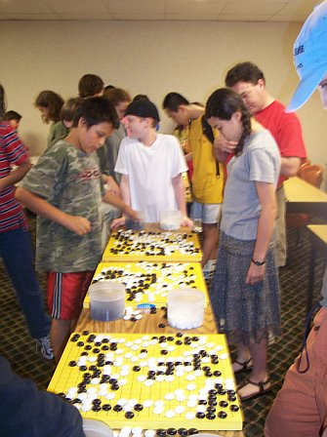

Slide 8
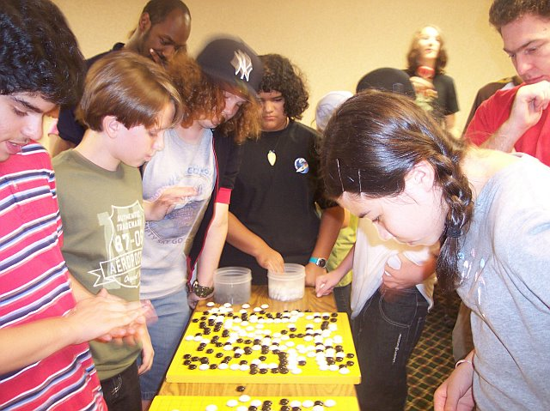

Slide 9
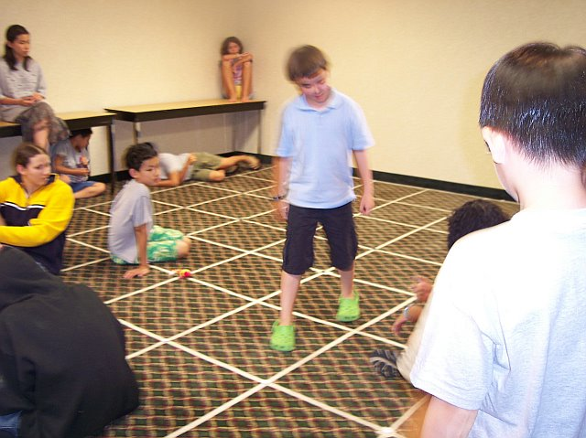
Human Go – The campers are the stones!

Slide 10
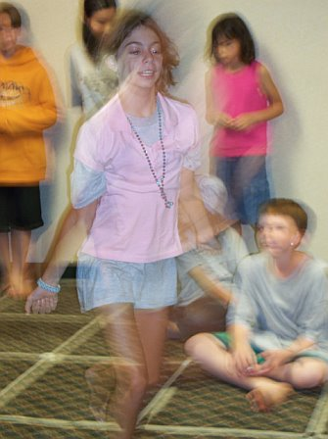

Slide 11
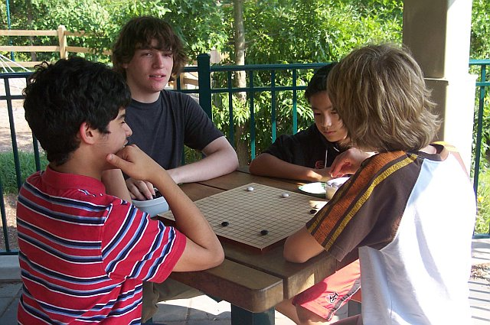
Summer Camp included outdoor activities too - mostly more go!

Slide 12
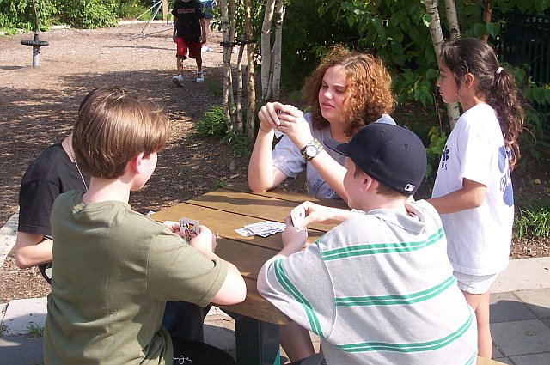
But some cards…

Slide 13
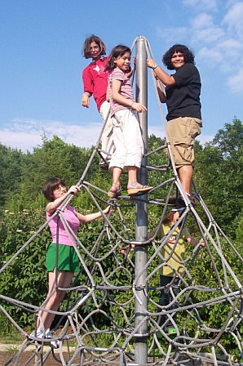
Climbing…

Slide 14
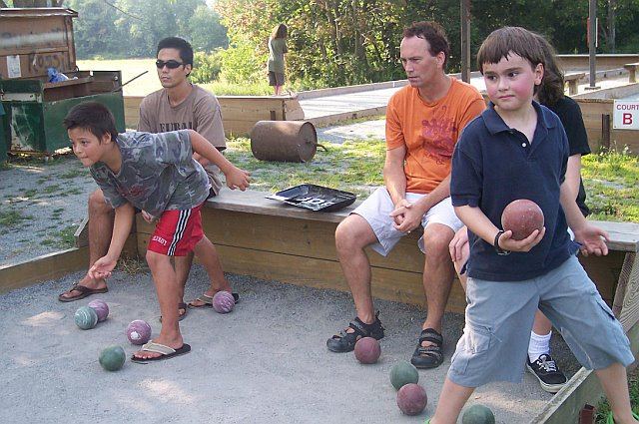
Bocce ball…

Slide 15
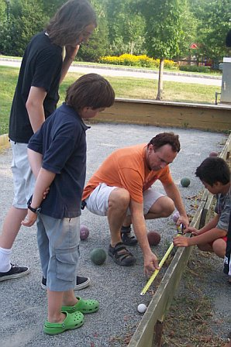

Slide 16
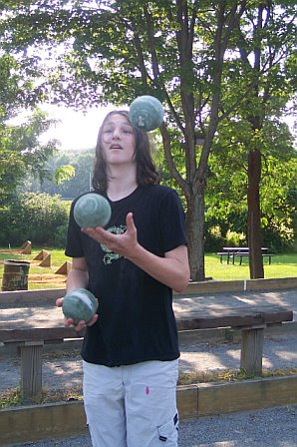
And even juggling

Slide 17
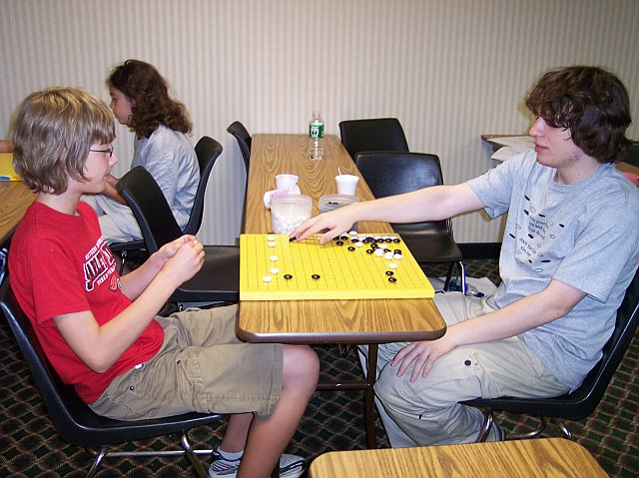
And every evening campers played ranked games into the night

Slide 18
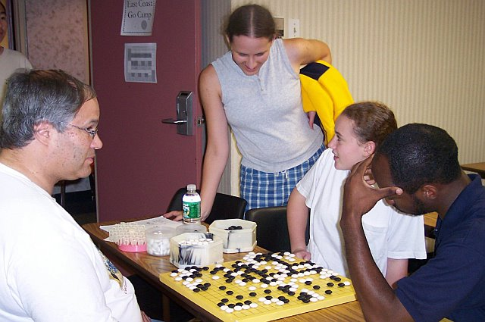

Slide 19
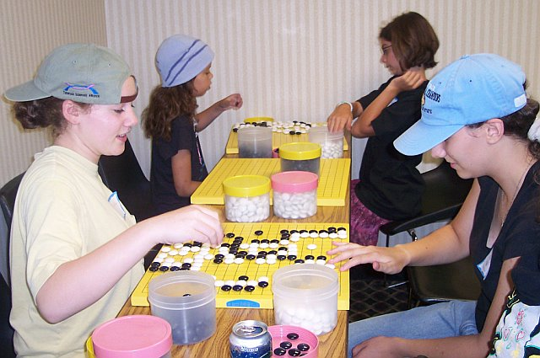

Slide 20
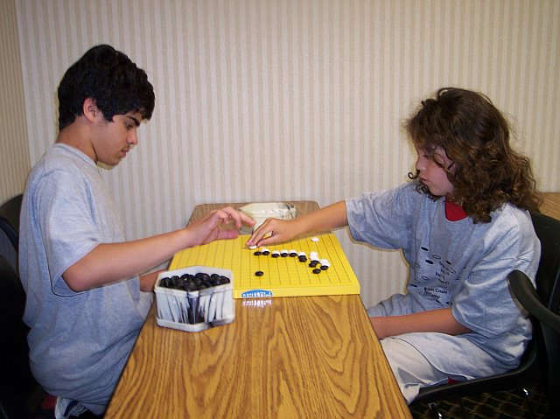

Slide 21
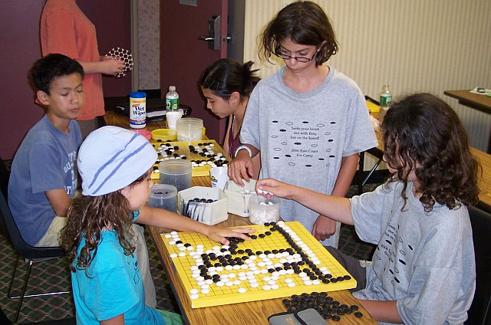

Slide 22
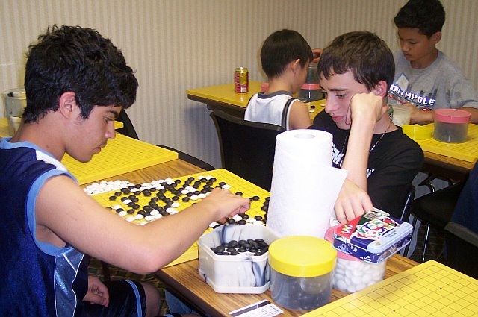

Slide 23
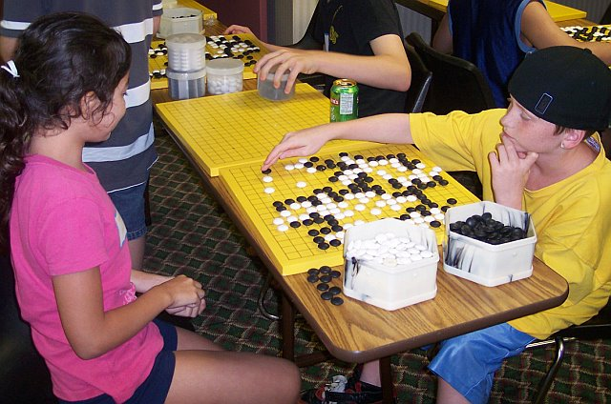

Slide 24
